Slide 1
Title I, Part D, Subpart 2 Grant Application
Federal Grant Programs Office
July 31, 2024

Slide 2
Welcome to the webinar
All participants are muted and your video is turned off
Please use the Q&A feature for questions (not chat)
This webinar is being recorded.
The slides and recording will be posted on the GEM$ homepage following the webinar: https://mass.egrantsmanagement.com/

Slide 3
Title I, Part D, Subpart 2 Allocations
Allocations are posted: https://www.doe.mass.edu/federalgrants/titlei-d/allocations.xlsx
22 districts
26 N/D facilities

Slide 4
Resources
https://www.doe.mass.edu/federalgrants/titlei-d/localprograms.html
Resource Guide has many topics, including:
Allowable uses of funds
District responsibilities
Data reporting requirements
Calendar
FY25 GEM$ application Worksheet

Slide 5
Allowable Uses of Funds
Teachers, assistants and/or other staff providing supplemental instruction/service
Supplemental supplies and materials, including technology
PD aligned with Title I, Part D
Family Engagement
Health and social services
Transition services
*Must be supplemental

Slide 6
Formal Agreement
District and N/D facility sign a formal agreement each year, which gets uploaded with the grant application
General information about the facility
Payment terms
Monitoring of the facility by the district
Signatures of both parties
Formal Agreement Template

Slide 7
District Responsibilities – Fiscal Agent
District acts as fiscal agent:
Part D allocation is budgeted as part of the Title I, Part A budget and set aside on the Title I District Reservations
District ensures funds are spent as outlined in Formal Agreement
Fiscal oversight may include collection of timesheets and invoices, and periodic check-ins with N/D facility coordinator

Slide 8
District Responsibilities – Monitoring
District monitors the N/D facility:
Set clear expectations at start of year regarding frequency and purpose of communications or visits with facility
Ensure that facility is carrying out responsibilities as outlined in formal agreement and complying with the grant
Conduct end of year evaluation of the impact of the Title I, Part D program, similar to Title I, Part A evaluation

Slide 9
Title I, D-2 Application in GEM$
Included as part of the ESSA Consolidated Grant Application (Title I, Parts A&D, Title IIA, Title IIIA, Title IVA)
District staff with the role of Grantwriter for the ESSA Consolidated grant will complete the application in GEM$
Part D section is based on ESEA Sec. 1423
Part D narrative questions will require collaboration with the N/D facility coordinator
FY25 ESSA grant applications are due September 9, 2024

Slide 10
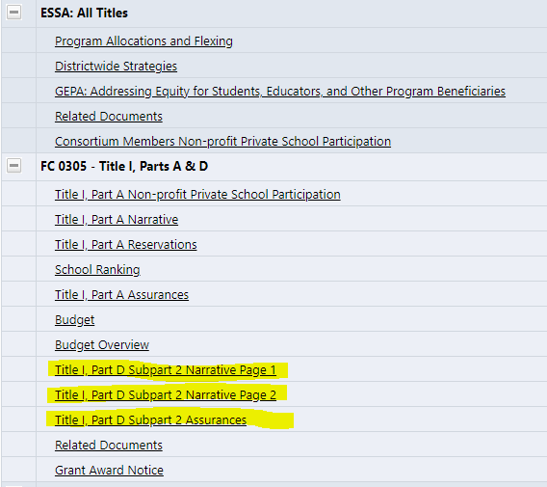
GEM$ Sections Page

Slide 11
Title I, D-2 Application – Program Details
N/D facility contact information
Description of the N/D facility, including characteristics of the children and youth served
Title I, D-2 activities
Brief description of activity
Amount of Title I, D-2 funds budgeted
Describe how activity is supplemental
Describe how the effectiveness of activity will be measured

Slide 12
Title I, D-2 Application – Program Coordination
Description of how the Title I, D-2 program will be coordinated with other Federal, State, and local programs
Description of how participating schools will coordinate with facilities to ensure that children and youth are enrolled in an education program that is comparable to the one in the local school they would otherwise attend
Description of how the program will involve parents and family members, as appropriate

Slide 13
Title I, D-2 Application – Transitions
Description of how the district will help to facilitate a successful transition for children and youth returning to public schools from the N/D facility

Slide 14
Title I, D-2 Application – Monitoring and Program Evaluation
Description of the district’s plan to monitor the facility to ensure that funds are spent in accordance with the formal agreement and grant regulations
Description of the district’s plan to evaluate the impact of Title I, D-2 activities on the children and youth in the facility

Slide 15
Title I, D-2 Application – Other Required Documents
Formal Agreement(s)

Slide 16
Live Demo in GEM$

Slide 17
Questions? contact your liaison or federalgrantprograms@mass.gov

