Slide 1
FY26 ESSA Consolidated Grant Application – Title I
July 17, 2025
Federal Grants Office

Slide 2
Welcome to the FY26 ESSA Consolidated Application Webinar!
Housekeeping items before we begin:
To preserve bandwidth, your video and microphone are turned off
Use the Q & A feature at the bottom of the screen to ask questions (Not chat)
This session is being recorded. The slides and recording will be posted on the GEM$ homepage following the webinar: https://mass.egrantsmanagement.com/

Slide 3
Update on ESSA Federal Funds
We received award notifications on July 1, 2025 for Title I- A & D.
DESE is working on calculating allocations
On June 30, 2025, all states received the following communication from the U.S. Department of Education: “Given the change in Administrations, the Department is reviewing the FY 2025 funding for II-A [Effective Educators, DESE grant fund code 140], III-A [English Learners, DESE grant fund codes 180 and 186], IV-A [Well-rounded Education, DESE grant fund code 309], grant program(s), and decisions have not yet been made concerning submissions and awards for this upcoming academic year. Accordingly, the Department will not be issuing Grant Award Notifications obligating funds for these programs on July 1 prior to completing that review.
An additional webinar will be held if and when funds are released.

Slide 4
Here to Help
RASP Contact Information
Email: federalgrantprograms@mass.gov
Website: www.doe.mass.edu/federalgrants
Grant Liaison List by district

Slide 5
Federal Grant Program RFPs
The RFPs will be posted under each fund code for FY26 at www.doe.mass.edu/grants.
Districts will be notified when allocations are released and when the application is live in GEM$.
The ESSA consolidated grant application is due in GEM$ by
September 9, 2025.

Slide 6
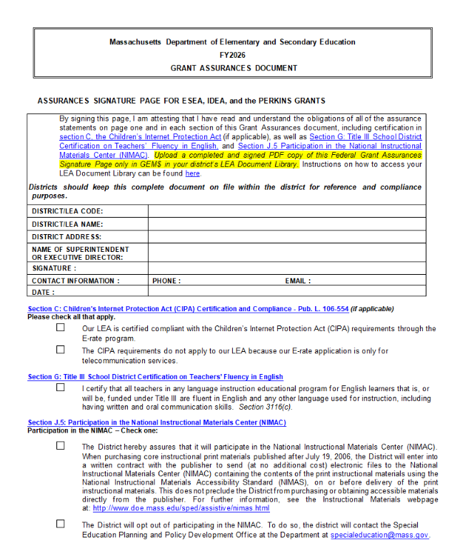
FY26 Grant Assurances
Review Grant Assurances document and upload signed signature page to GEM$ in your district’s LEA Document Library under FY26
Posted in the RFP and under General Resources for Federal Grant Programs at:
http://www.doe.mass.edu/federalgrants/resources/

Slide 7
GEM$ Roles
To be added to the system/a specific grant, please contact your district’s User Access Administrator (UAA) to assign you a GEM$ role (multiple people can have the same role)
To find your district’s UAA, use the left navigation menu to access the “Address Book”
You will need the role of ESSA Consolidated Grantwriter in order to complete the ESSA application in GEM$

Slide 8
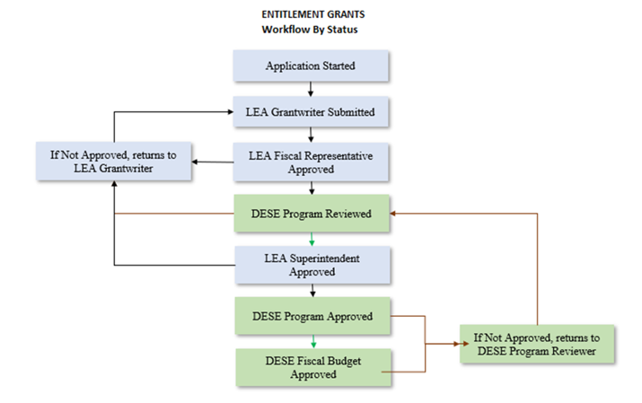
GEM$ Access – Workflow
The start date of your ESSA grants will be the date of the LEA Fiscal Rep Approval

Slide 9
GEM$ Signoffs
The Superintendent/Chief Executive role must be held and should be exercised by the actual organizational leader.
The Superintendent/Chief Executive must approve funding applications in GEM$ unless unavailable to approve for a length of time that would unreasonably delay submission of the funding application.
All funding applications require at least 2 sets of eyes from an LEA – the Superintendent and at least one other (either the LEA Fiscal Representative or the LEA Grantwriter, or both).
In no case should a funding application be created/approved by the same person holding all three LEA roles.
Note: The same person may be assigned all three roles in GEM$ (although this would be unusual) but cannot exercise all three roles on the same funding application.

Slide 10
LEA Requirements for GEM$ User Roles - Guidance and Forms
DESE has created a GEM$ LEA User Role Resource Guide designed to describe the capabilities and responsibilities that each role has in GEM$, as well as DESE’s expectations for how these roles will be used and managed by each LEA. In addition to the resource guide, DESE has created several forms (linked below) that must be used if a district wishes to assign new roles to staff. Some forms will be sent directly to DESE, others uploaded to GEM$, and the majority will solely be kept on file with the LEA. The GEM$ LEA User Role Diagram for Use of Forms provides an overview and instructions for using the forms. User Role Forms for all GEM$ Roles: GEM$ First User Access Administrator Form GEM$ Alternate User Access Administrator form GEM$ LEA General User form GEM$ LEA Superintendent Chief Exec form GEM$ Vendor Authorization User form The forms, as well as the resource guide, are also posted on the DESE Resources page of GEM$.

Slide 11
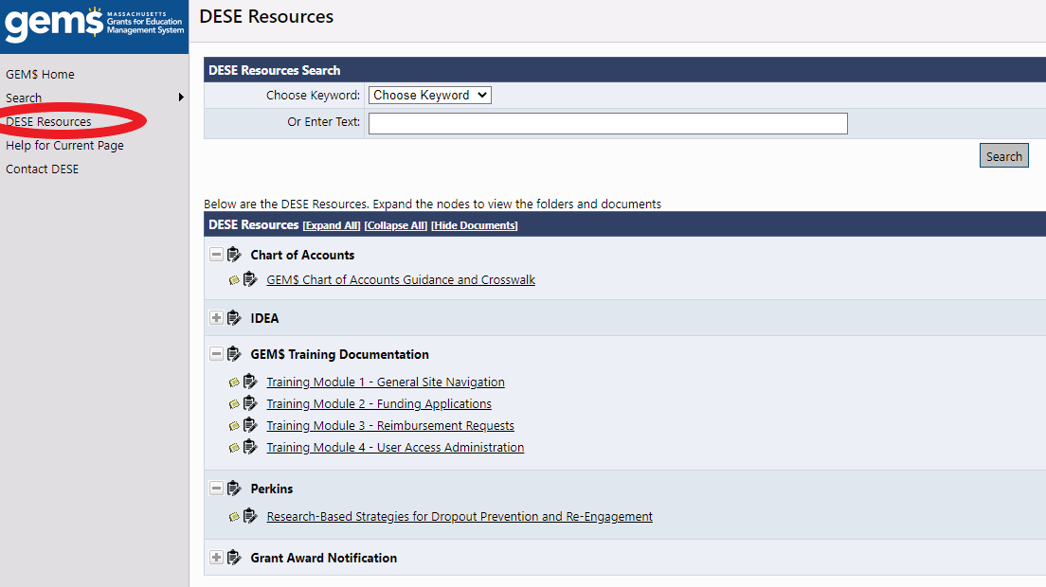
GEM$ Resources – DESE Resources

Slide 12
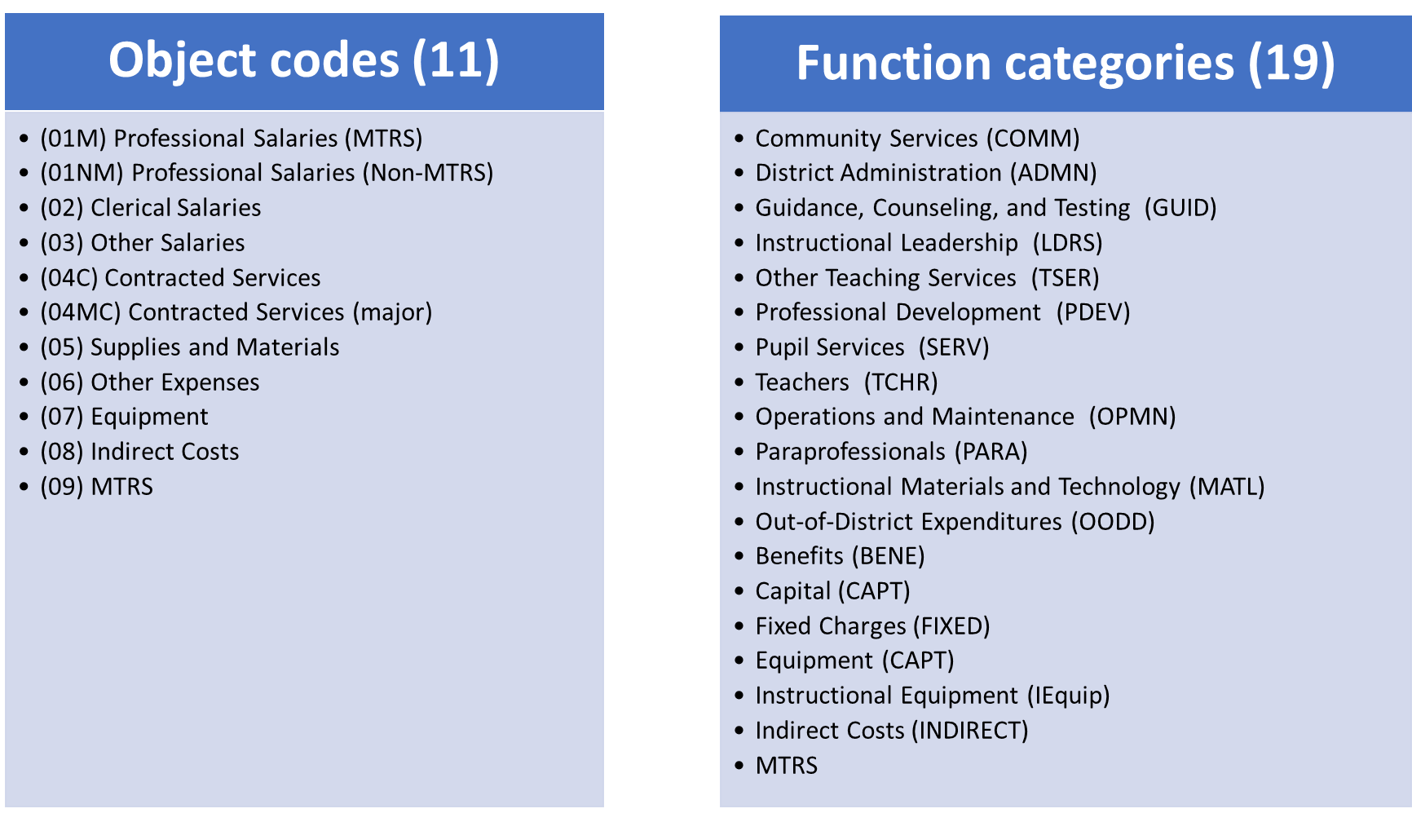
GEM$ Chart of Accounts
GEM$ includes dropdown menus for object codes and function codes (organized by function categories)
Designed to align with your local accounting systems, streamline grant budgeting, and facilitate EOYR reporting

Slide 13
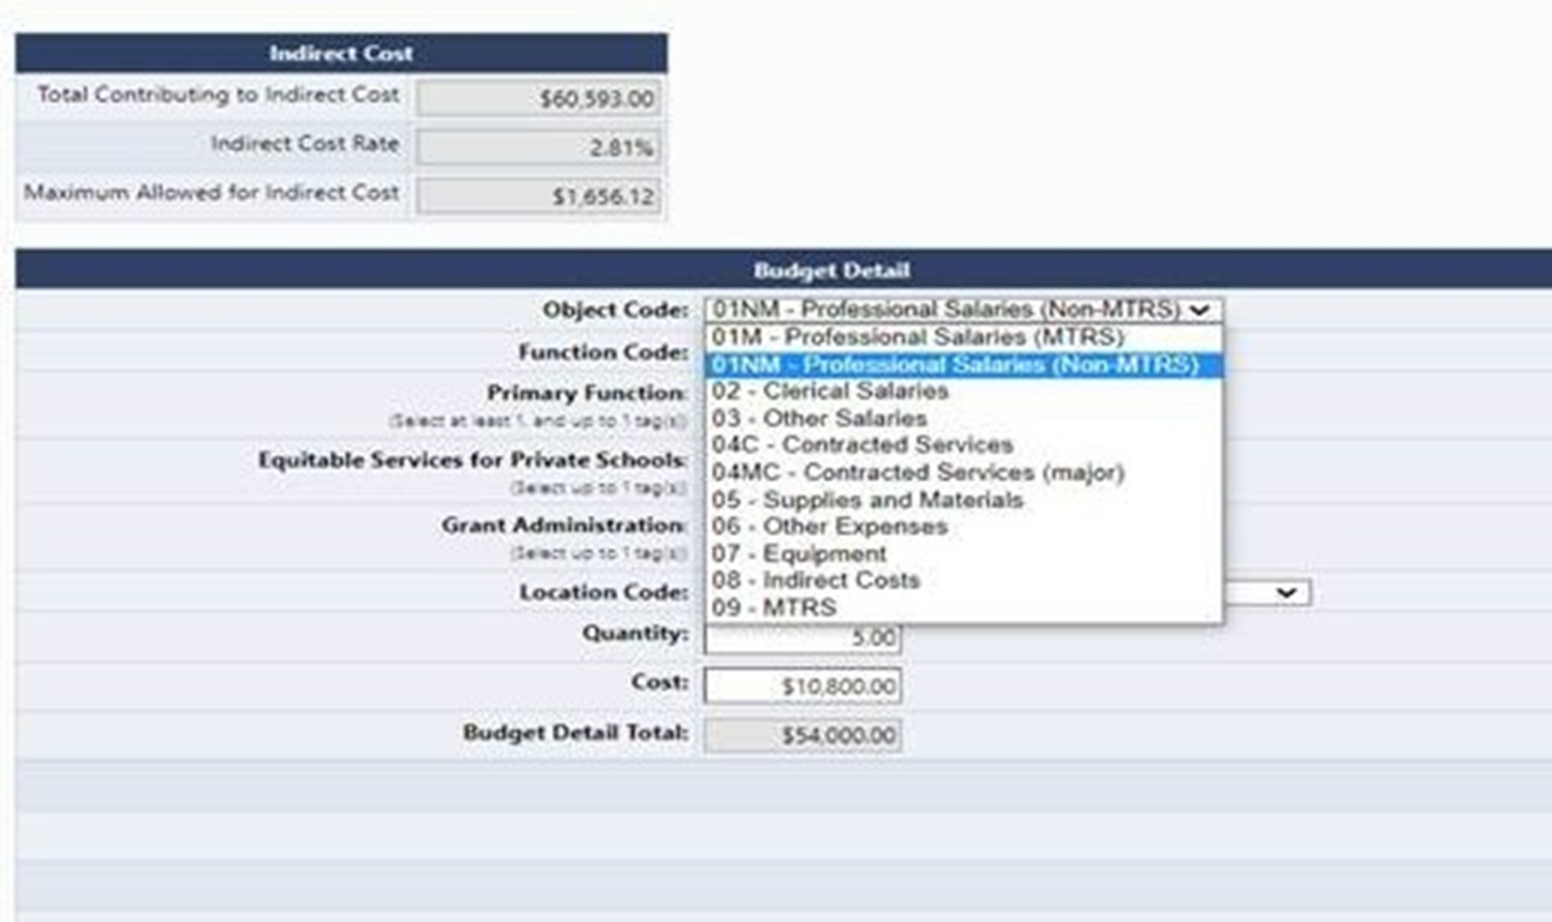
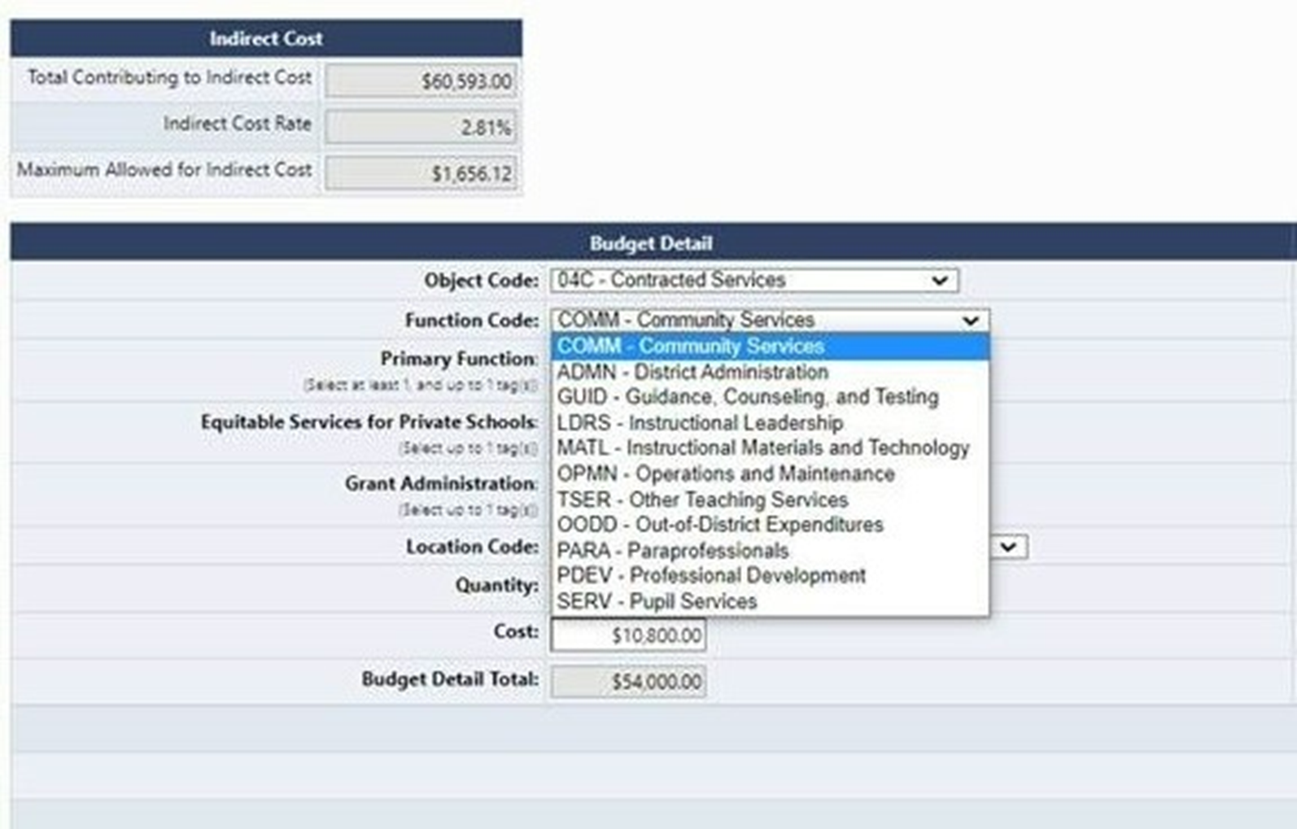
GEM$ Chart of Accounts
Object Codes
Function Codes

Slide 14
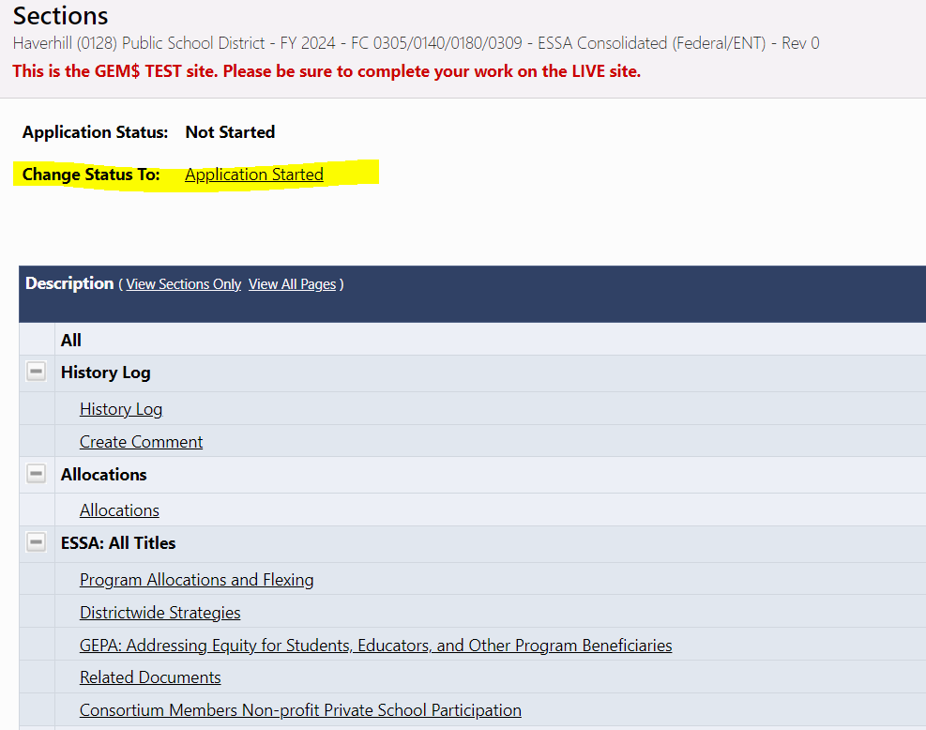
Start the Application
Important:
At the top of the Sections page, you must first change the status to Application Started

Slide 15
Checklist – DESE Reviewers Comments
Check the Checklist and Reviewer Comments located at the top of the grant’s sections page for your Federal Grant Liaison’s comments when your grant application has been returned to you.
Make sure all comments have been addressed before re-submitting the grant back to DESE.

Slide 16
Live Demo in GEM$

Slide 17
Resources
RFPs will be posted: https://www.doe.mass.edu/grants/grants.aspx?sortby=fundcode&direction=asc
Chart of Accounts: https://mass.egrantsmanagement.com/DocumentLibrary/ViewDocument.aspx?DocumentKey=1714&inline=true
Federal Grants Website: https://www.doe.mass.edu/federalgrants/essa/default.html
Quick Reference Guides
Title I: https://www.doe.mass.edu/federalgrants/titlei-a/resources/qrg.docx
Title IIA: https://www.doe.mass.edu/federalgrants/titleii-a/qrg.docx
Title IIIA: https://www.doe.mass.edu/federalgrants/titleiii-a/resources/qrg.docx
Title IVA: https://www.doe.mass.edu/federalgrants/titleiv-a/qrg.docx
Title IVA Resource Guide: https://www.doe.mass.edu/federalgrants/titleiv-a/resource-guide.docx
Access to Well-Rounded Education Quick Reference Guide: https://www.doe.mass.edu/federalgrants/titleiv-a/wellrounded-education-qrg.docx
Effective Use of Technology Quick Reference Guide: https://www.doe.mass.edu/federalgrants/titleiv-a/effective-use-of-tech-qrg.docx
Safe and Healthy Schools Quick Reference Guide: https://www.doe.mass.edu/federalgrants/titleiv-a/safe-healthy-schools-qrg.docx

Slide 18
Questions?
Contact your Federal Grants Liaison
https://www.doe.mass.edu/federalgrants/liaisons.xlsx
Or
federalgrantprograms@mass.gov

