Slide 1
EXPANDED HOMELESS SHELTER DATA COLLECTION
NOVEMBER 2024

Slide 2
AGENDA
Data Collection Process for Supplemental Funding support
School of Origin Transportation Accelerated Reimbursement (for consolidation communities only)
Contact Information & Resources

Slide 3
MASSACHUSETTS SHELTER SYSTEM
Statewide
~7,500 families
~5,000+ school-aged children
Emergency Expansion Shelter Sites
~80 communities
Temporary Respite Centers (TRCs)
Families are being added to the waiting list

Slide 4
STATE SUPPLEMENTAL FUNDING SUPPORT
$104.89 per day per student enrolled in the district for all days in membership this school year
Equivalent to $18,000 annually, the state’s annual per pupil rate​
More than $40M paid to ~80 districts in 2023-2024
Paid for students who were placed in an eligible shelter in your district and enrolled in your district any time after October 1, 2023.
Payments will be made for students based on total days in membership through December 6th

Slide 5
STATE SUPPLEMENTAL FUNDING SUPPORT
Funds must be deposited in a separate account, like a state grant, and made available to the school committee without further appropriation.
Funds can be used to support instructional services and any other services that the district is providing to homeless students and their families.
Funds will be prepopulated on Schedule 1 of the district's End of Year Financial Report (EOYR) as a DESE Administered State Grant (line 510).
Expenditures should be reported in Schedules 3 and 20 under Other DESE Administered State Grants in the appropriate function code(s).

Slide 6
ELIGIBLE STUDENTS
Placed in an eligible emergency expansion shelter site or temporary respite center in your community and enrolled in your district
Including students:
who have since moved to another shelter placement, and who continue to be enrolled in your district
who have moved to a consolidated emergency expansion shelter site and who enroll locally in your district
who have since secured permanent housing (they are eligible under MKV to return to their SOO through the end of the school year)

Slide 7
NON-ELIGIBLE STUDENTS
Students experiencing homelessness who are not eligible for these reimbursements include students who are:
Doubled up
Placed in a traditional shelter
Unsheltered (cars, parks, campgrounds, abandoned buildings, and substandard/inadequate housing)
Hotels/motels (that are not part of the state shelter system)
*Do not check the “Emergency Shelter Expansion” check box for these students.

Slide 8
DECEMBER 2024 DATA COLLECTION PROCESS
By December 6, for eligible students:
In your student information management system (SIS) flag eligible students as homeless, and indicate their current dwelling arrangement
Once SIF has run, all students flagged as homeless will appear in DESE’s Homeless and Foster Care Application on the Security Portal
In the Homeless and Foster Care Application, check the “Emergency Shelter Expansion” checkbox
On December 9th, DESE will pull days in membership for students with the “Emergency Shelter Expansion” flag from data transmitted through SIF.
This is not a certified data file so we may follow up with you for additional information, as needed.

Slide 9
ACCESSING THE HOMELESS/FOSTER CARE APPLICATION
You must be assigned the Homeless and Foster Care Student Application by your school district's Directory Administrator. See Directory Administrator page for further information.
Once you are assigned the role, Homeless and Foster Care Students will appear on your application list.

Slide 10
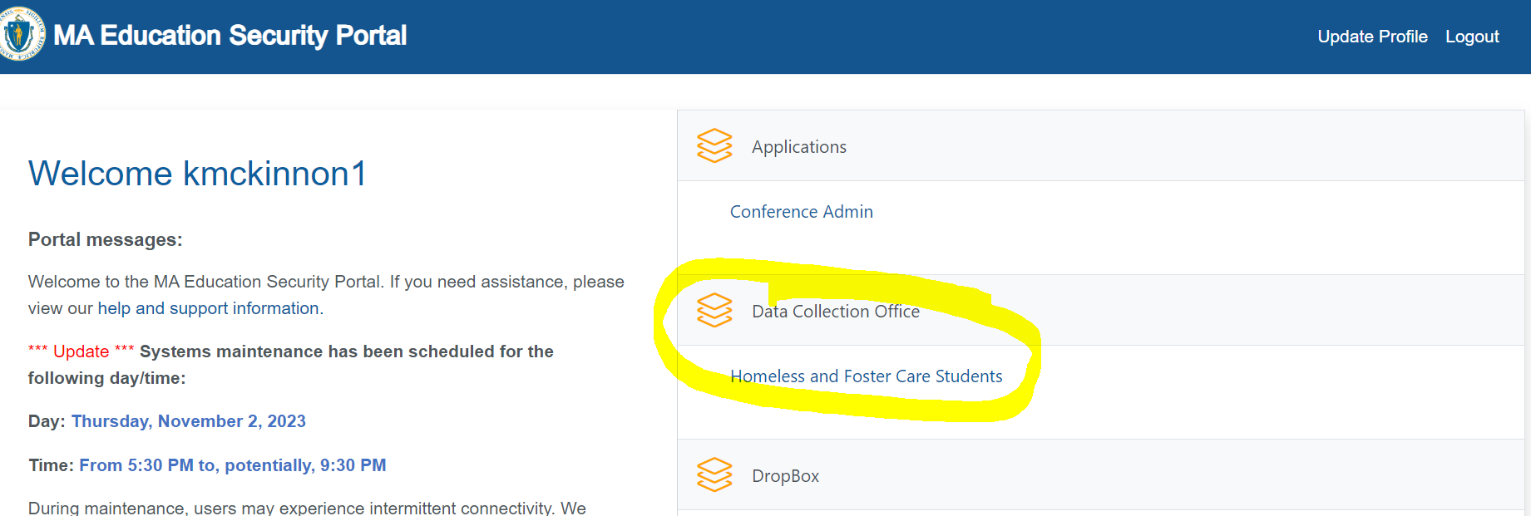
HOMELESS/FOSTER CARE APPLICATION

Slide 11
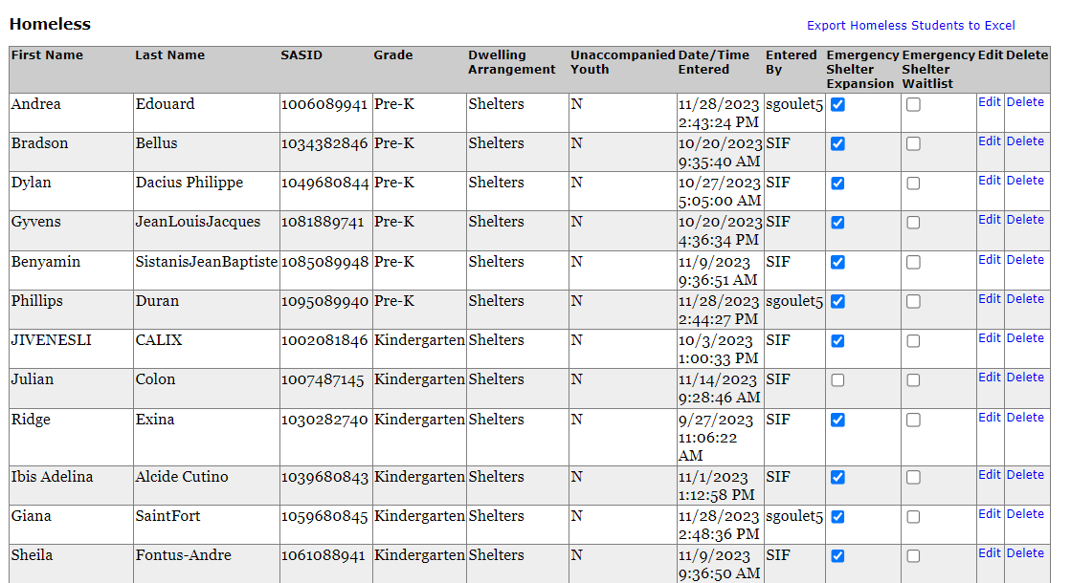

Slide 12
IMPORTANT REMINDERS
Identify only eligible students (see slides 5 & 6).
Reimbursement is based on enrollment (days in membership) rather than attendance.
Please update student records to flag all eligible students by Friday, December 6, 2024.

Slide 13
SCHOOL OF ORIGIN TRANSPORTATION - ACCELERATED REIMBURSEMENT
For students affected by state shelter consolidations occurring between December 1, 2023 – June 30, 2024, and who are returning to their school of origin.
Impacted districts submit School of Origin Transportation Reimbursement Claim Forms for eligible transportation costs incurred:
The first day of school 2024 – December 20, 2024 (submit by January 6, 2025)
All transportation costs for students experiencing homelessness returning to their SOO should be reported on districts’ EOYR.

Slide 14
SCHOOL OF ORIGIN TRANSPORTATION - ACCELERATED REIMBURSEMENT
All transportation costs for students experiencing homelessness and returning to their SOO should be reported on districts’ EOYR submitted in the end of the school year.
The reimbursement a district receives through these accelerated payments in FY24 will be deducted from the total SOO transportation reimbursement for FY24 that is issued in FY25, subject to appropriation.

Slide 15
SCHOOL OF ORIGIN TRANSPORTATION – TRADITIONAL REIMBURSEMENT
REMINDER: All students experiencing homelessness have a right to transportation, if needed, to return to their SOO.
Transportation costs are shared by the SOO district and the district in which a student is residing.
State funding, subject to appropriation, is available to reimburse these costs.
Reimbursement varies based on total amount appropriate and total costs reported and is paid in the following fiscal year following EOYR audits.

Slide 16
CONTACT INFORMATION
Data Reporting Questions
Kristen McKinnon or Rob O’Donnell
Emergency Shelter Site Questions
Anne Marie Stronach or Shirley Fan-Chan
Website with resources:
https://www.doe.mass.edu/csdp/New-Students/

