Slide 1
FY25 ESSA Consolidated Grant Application
July 16, 2024
Federal Grants Office

Slide 2
Welcome to the FY25 ESSA Consolidated Application Webinar!
Housekeeping items before we begin:
To preserve bandwidth, your video and microphone are turned off
Use the Q & A feature at the bottom of the screen to ask questions (Not chat)
This session is being recorded. The slides and recording will be posted on the GEM$ homepage following the webinar: https://mass.egrantsmanagement.com/

Slide 3
Here to Help
RASP Contact Information
Email: federalgrantprograms@mass.gov
Website: www.doe.mass.edu/federalgrants
Grant Liaison List by district

Slide 4
Federal Grant Program RFPs
The RFPs are posted under each fund code for FY25 at www.doe.mass.edu/grants.
Districts will be notified when allocations are released and when the application is live in GEM$.
The ESSA consolidated grant application is due in GEM$ by
September 9, 2024.

Slide 5
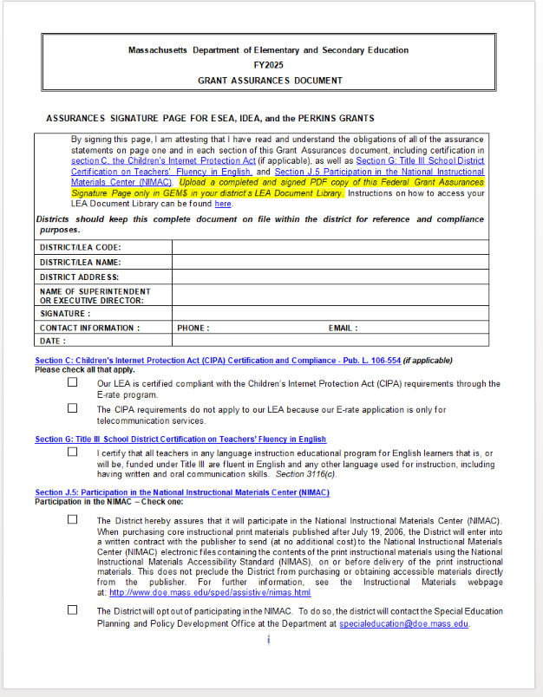
FY25 Grant Assurances
Review Grant Assurances document and upload signed signature page to GEM$ in your district’s LEA Document Library under FY25
Posted in the RFP and under General Resources for Federal Grant Programs at:
http://www.doe.mass.edu/federalgrants/resources/

Slide 6
Quick Reminders about EdGrants & GEM$
Both EdGrants (FY23 and before) and GEM$ (FY24 and forward) will simultaneously be live and accessible
FY23 ESSA grants end 9/30/24
Check the RFP if unsure which grants are in EdGrants vs GEM$
The GEM$ site URL is https://mass.egrantsmanagement.com/

Slide 7
GEM$ Roles
To be added to the system/a specific grant, please contact your district’s User Access Administrator (UAA) to assign you a GEM$ role (multiple people can have the same role)
To find your district’s UAA, use the left navigation menu to access the “Address Book”
You will need the role of ESSA Consolidated Grantwriter in order to complete the ESSA application in GEM$

Slide 8
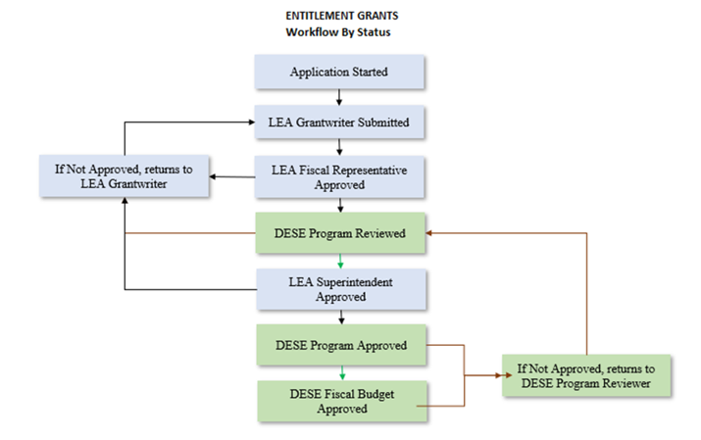
GEM$ Access – Workflow
The start date of your ESSA grants will be the date of the LEA Fiscal Rep Approval

Slide 9
GEM$ Signoffs
The Superintendent/Chief Executive role must be held and should be exercised by the actual organizational leader.
The Superintendent/Chief Executive must approve funding applications in GEM$ unless unavailable to approve for a length of time that would unreasonably delay submission of the funding application.
All funding applications require at least 2 sets of eyes from an LEA – the Superintendent and at least one other (either the LEA Fiscal Representative or the LEA Grantwriter, or both).
In no case should a funding application be created/approved by the same person holding all three LEA roles.
Note: The same person may be assigned all three roles in GEM$ (although this would be unusual) but cannot exercise all three roles on the same funding application.

Slide 10
LEA Requirements for GEM$ User Roles - Guidance and Forms
DESE has created a GEM$ LEA User Role Resource Guide designed to describe the capabilities and responsibilities that each role has in GEM$, as well as DESE’s expectations for how these roles will be used and managed by each LEA. In addition to the resource guide, DESE has created several forms (linked below) that must be used if a district wishes to assign new roles to staff. Some forms will be sent directly to DESE, others uploaded to GEM$, and the majority will solely be kept on file with the LEA. The GEM$ LEA User Role Diagram for Use of Forms provides an overview and instructions for using the forms. User Role Forms for all GEM$ Roles: GEM$ First User Access Administrator Form GEM$ Alternate User Access Administrator form GEM$ LEA General User form GEM$ LEA Superintendent Chief Exec form GEM$ Vendor Authorization User form The forms, as well as the resource guide, are also posted on the DESE Resources page of GEM$.

Slide 11
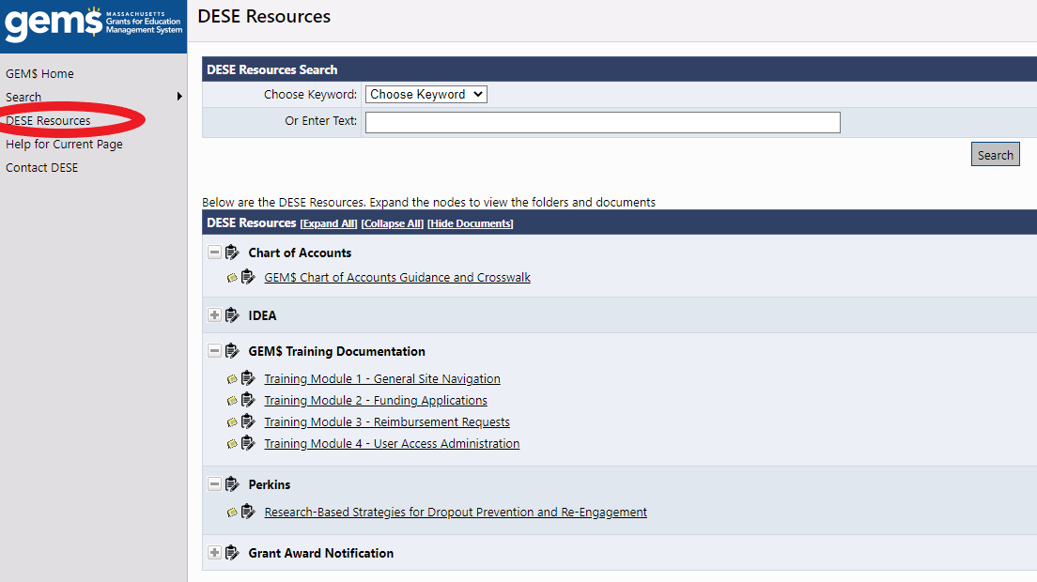
GEM$ Resources
DESE Resources

Slide 12
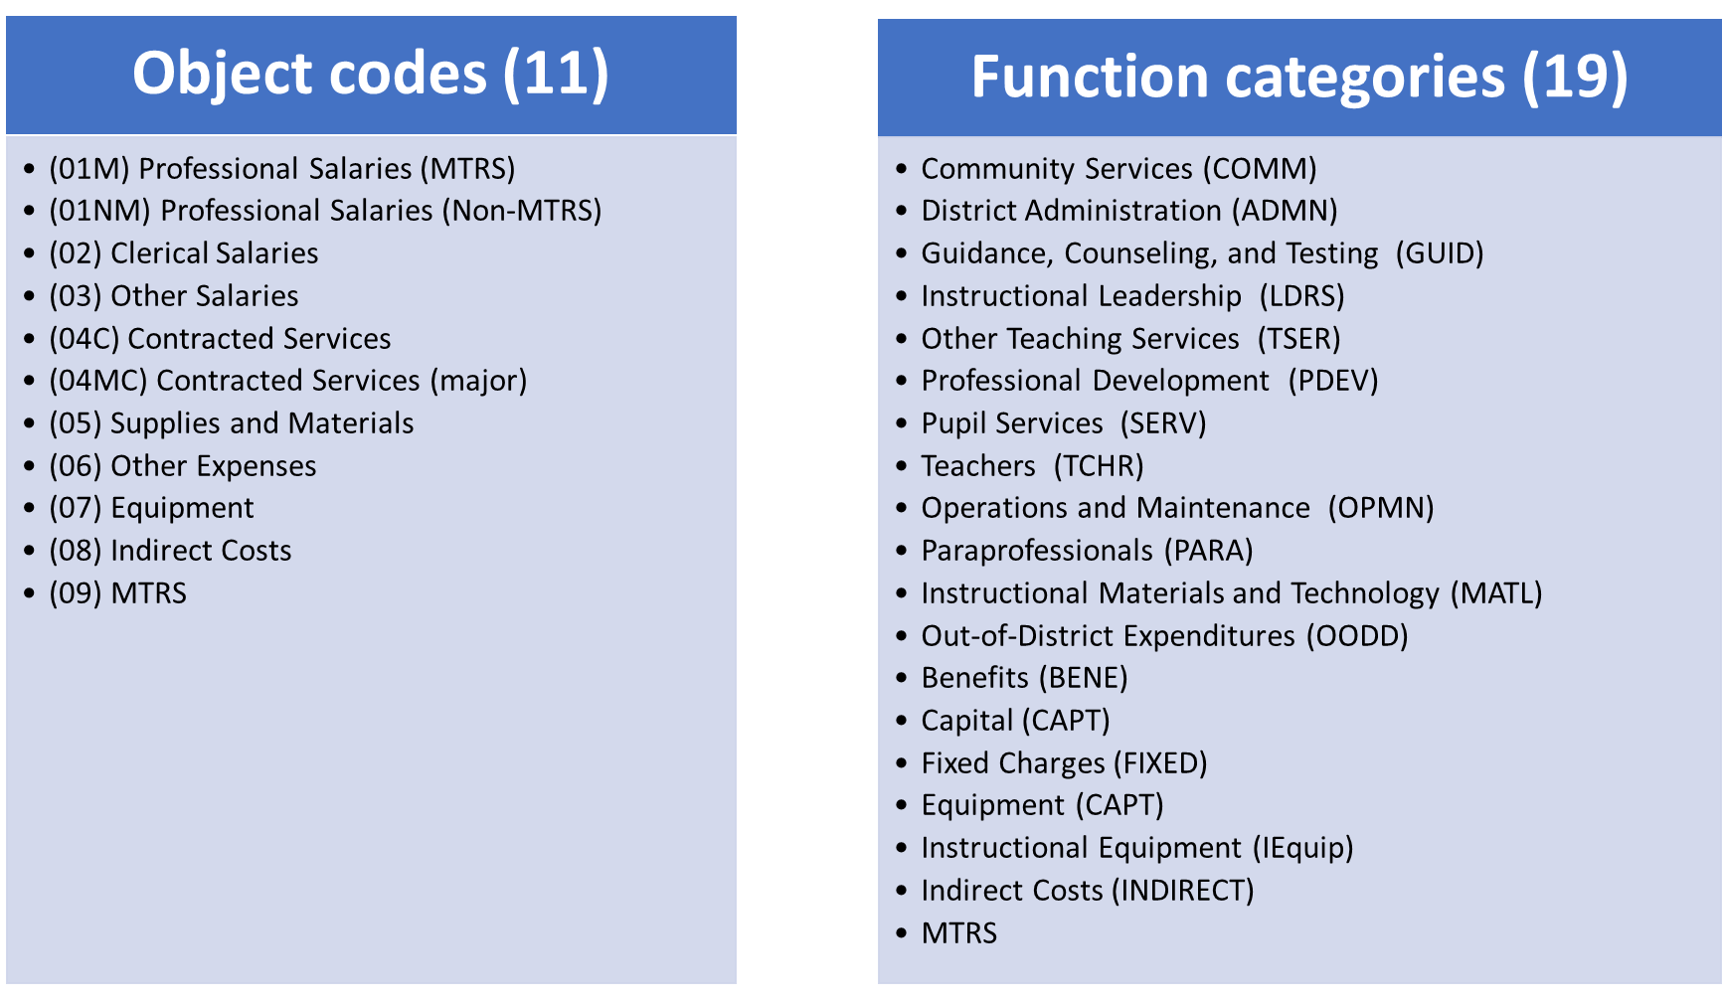
GEM$ Chart of Accounts
GEM$ includes dropdown menus for object codes and function codes (organized by function categories)
Designed to align with your local accounting systems, streamline grant budgeting, and facilitate EOYR reporting

Slide 13
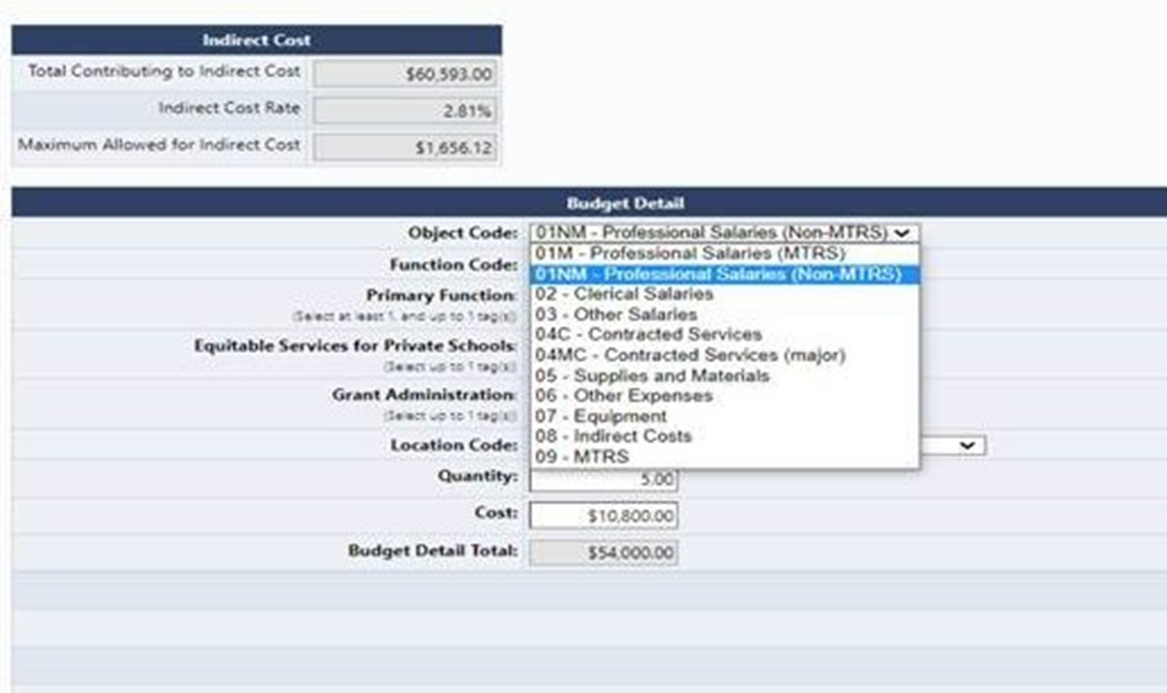
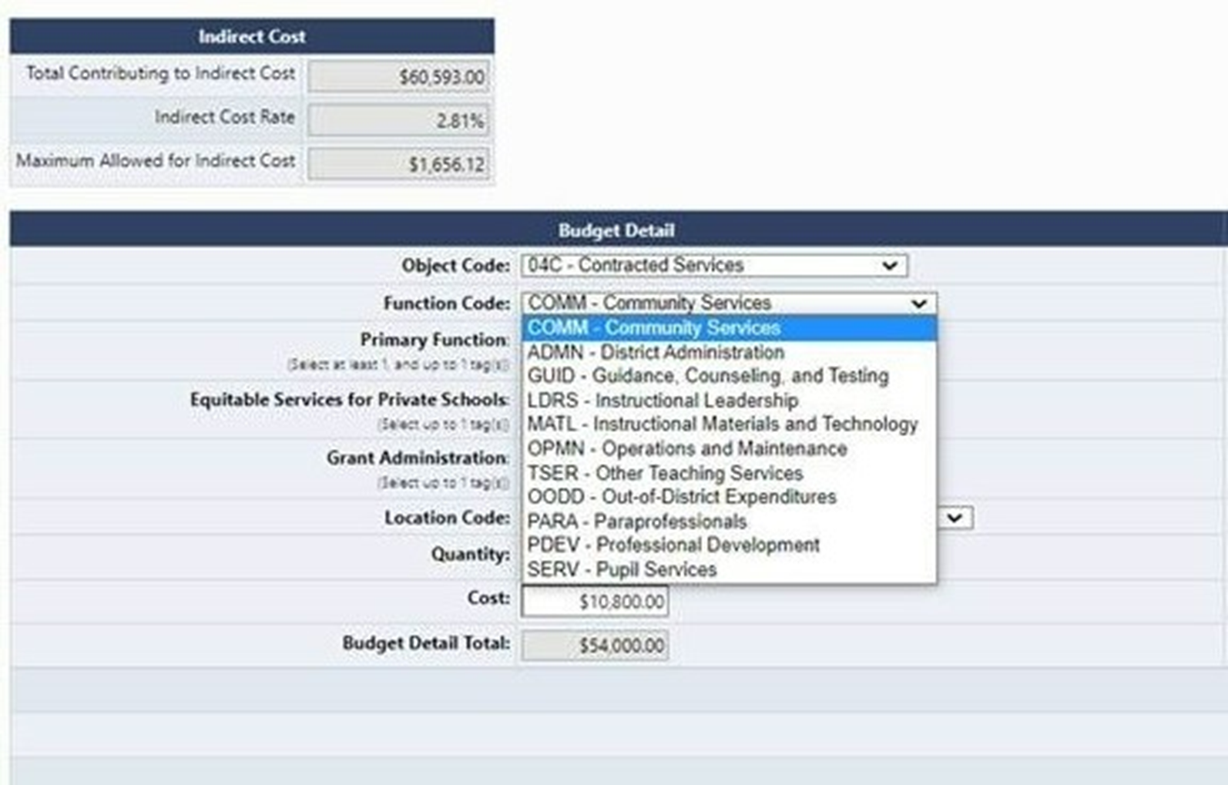
GEM$ Chart of Accounts
Object Codes
Function Codes

Slide 14
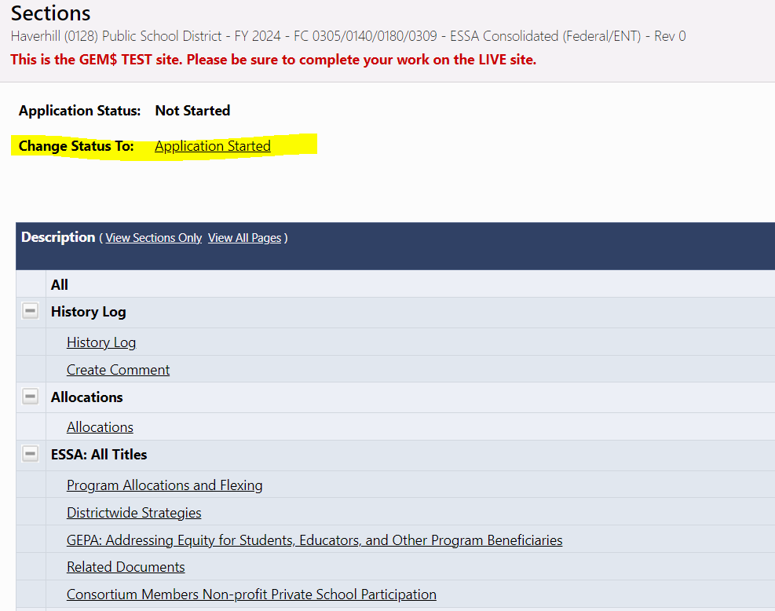
Start the Application
Important:
At the top of the Sections page, you must first change the status to Application Started

Slide 15
Checklist – DESE Reviewers Comments
Check the Checklist and Reviewer Comments located at the top of the grant’s sections page for your Federal Grant Liaison’s comments when your grant application has been returned to you.
Make sure all comments have been addressed before re-submitting the grant back to DESE.

Slide 16
Live Demo in GEM$

Slide 17
Resources
RFPs:
Title I FC 0305: https://www.doe.mass.edu/grants/2025/0305/
Title IIA FC 0140: https://www.doe.mass.edu/grants/2025/0140/
Title III FC 0180: https://www.doe.mass.edu/grants/2025/0180/
Title IVA FC 0309: https://www.doe.mass.edu/grants/2025/0309/
Chart of Accounts: https://mass.egrantsmanagement.com/DocumentLibrary/ViewDocument.aspx?DocumentKey=1714&inline=true
Federal Grants Website: https://www.doe.mass.edu/federalgrants/essa/default.html
Quick Reference Guides
Title I: https://www.doe.mass.edu/federalgrants/titlei-a/resources/qrg.docx
Title IIA: https://www.doe.mass.edu/federalgrants/titleii-a/qrg.docx
Title III: https://www.doe.mass.edu/federalgrants/titleiii-a/resources/qrg.docx
Title IVA: https://www.doe.mass.edu/federalgrants/titleiv-a/qrg.docx
New: Title IVA Resource Guide: https://www.doe.mass.edu/federalgrants/titleiv-a/resource-guide.docx
Access to Well-Rounded Education Quick Reference Guide: https://www.doe.mass.edu/federalgrants/titleiv-a/wellrounded-education-qrg.docx
Effective Use of Technology Quick Reference Guide: https://www.doe.mass.edu/federalgrants/titleiv-a/effective-use-of-tech-qrg.docx
Safe and Healthy Schools Quick Reference Guide: https://www.doe.mass.edu/federalgrants/titleiv-a/safe-healthy-schools-qrg.docx

Slide 18
Questions?
Contact your Federal Grants Liaison
https://www.doe.mass.edu/federalgrants/liaisons.xlsx
Or
federalgrantprograms@mass.gov

