Slide 1
Consortia Fiscal Agents and Members: How to Apply for IDEA and ESSA Entitlement Grants in GEM$
Revised for Presentation
July 27, 2023

Slide 2
Agenda
GEM$ Mechanics: General issues for all consortia
IDEA
Member sections and responsibilities
Fiscal Agent sections and responsibilities
ESSA
All Titles
Title I – special considerations
Title III – special consideration
Communicating among consortia members in GEM$
Providing access to fiscal agents to member districts’ funding applications
Sending pdfs in GEM$

Slide 3
Why the Intent to Participate?
For Consortia, the Intent to Participate allows DESE to:
Assign member districts’ allocations to the Fiscal Agent for budgeting on its funding application and assign all consortia schools to one Title I School Ranking page
Limit the application sections visible to and required of consortium members – for example, no budgets, no School Ranking section for Title I
Avoid collecting a Schedule A document separately
No More Schedule A!

Slide 4
Consortium Terminology and Responsibilities
No More Schedule A!
Fiscal Agent = Lead District
Indicates on Intent to Participate that it is a Lead District for a consortium
Submits funding application with budget for the consortium
Ensures each member completes all applicable nonbudget sections
Administers funds for the consortium
Ensures services are provided for members
Monitors compliance with all grant requirements for the consortium
Submits any special documentation (e.g., Title III Memorandum of Understanding, see here).
Member District = Nonlead districts
Indicates on Intent to Participate that it is joining a consortium, identifying the Fiscal Agent
Completes the nonbudget sections of the funding application for the grant program(s)
Provides Fiscal Agent with needed information from its funding application - either access to or a pdf copy of its funding application

Slide 5
All grant recipients, even members of consortia, will need to complete funding applications for ESSA and IDEA.
Funding applications for member districts are abbreviated – no budget sections and limited program sections.
To fill out their abbreviated funding applications, member districts’ User Access Administrator must assign all roles in the workflow:
LEA Grantwriter for Funding Applications
Fiscal Representative
Superintendent/Chief Executive

Slide 6
Funding application pages that all districts will need to complete, including members of consortia, if applicable:
IDEA Consolidated (FC 240 & FC 262) | ESSA Consolidated (Titles I-IV) (FC 305, FC 140, FC 180 & FC 309)
Maintenance of Effort (MOE) | Title I, Part A Non-profit Private School Participation √
CEIS (optional), CCEIS √, and Making Money Matter (M³) √ | Title II, Part A Non-profit Private School Participation √
Equitable Services √ | Title III, Part A Non-profit Private School Participation √
Equitable Services Carryover √ | Title IV, Part A Non-profit Private School Participation √
IDEA Assurances | GEPA Questions
Conditions of Assistance (upload)
GEPA Questions
= all member districts must complete
√ = member districts must complete if applies

Slide 7
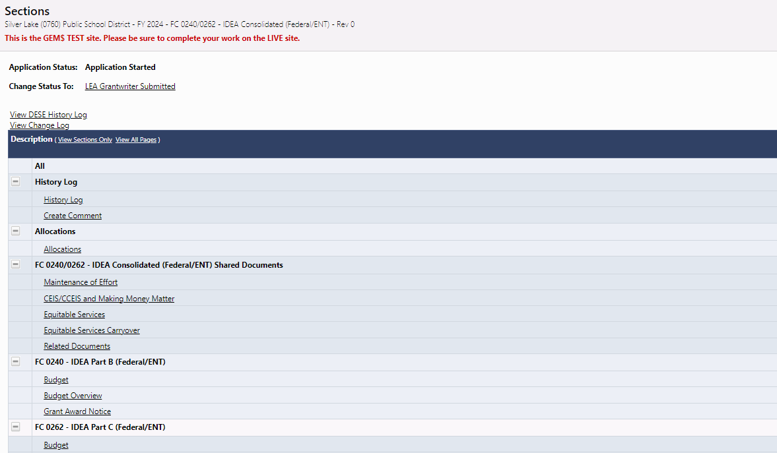
The Allocations page of the application will show funds being assigned from member districts to the Fiscal Agent.
Go to Allocations
Page

Slide 8
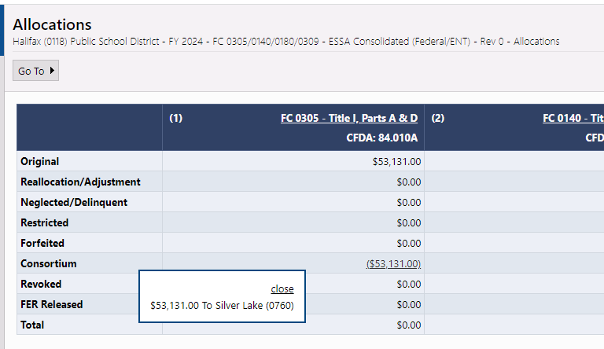
Members see their allocation has been assigned to fiscal agent
Assignment to Fiscal Agent appears
Hover over consortium allocation

Slide 9
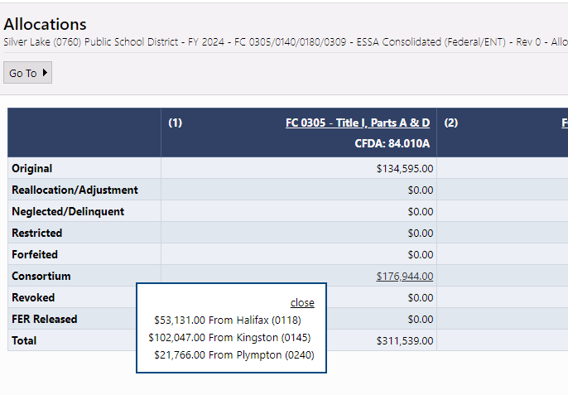
Fiscal Agents see members’ allocations
Members
Allocations appear
Hover over consortium allocation

Slide 10
IDEA Consolidated Funding Application

Slide 11
IDEA: The Fiscal Agent will see the entire funding application, including the budget, on the Sections page.
These sections will not appear on Member Districts Applications

Slide 12
IDEA: Member districts will only see those parts of the funding application that they may need to complete and never the Budget sections.
This district assigns funds to a fiscal agent for both Fund Code 240 and 262, so no budgets for 240 or 262. The sections that remain are required (if applicable) for individual grant recipients.

Slide 13
IDEA: Member districts will be responsible for outreach and calculation of Equitable Services for eligible schools and students from their districts.
Member sections of funding applications will include equitable services pages, that may include:
Questions about outreach to those eligible to be served
Uploads for Affirmations of Consultation with private-school officials/parents

Slide 14
IDEA: Lead districts will need information from their members’ funding applications for equitable services

Slide 15
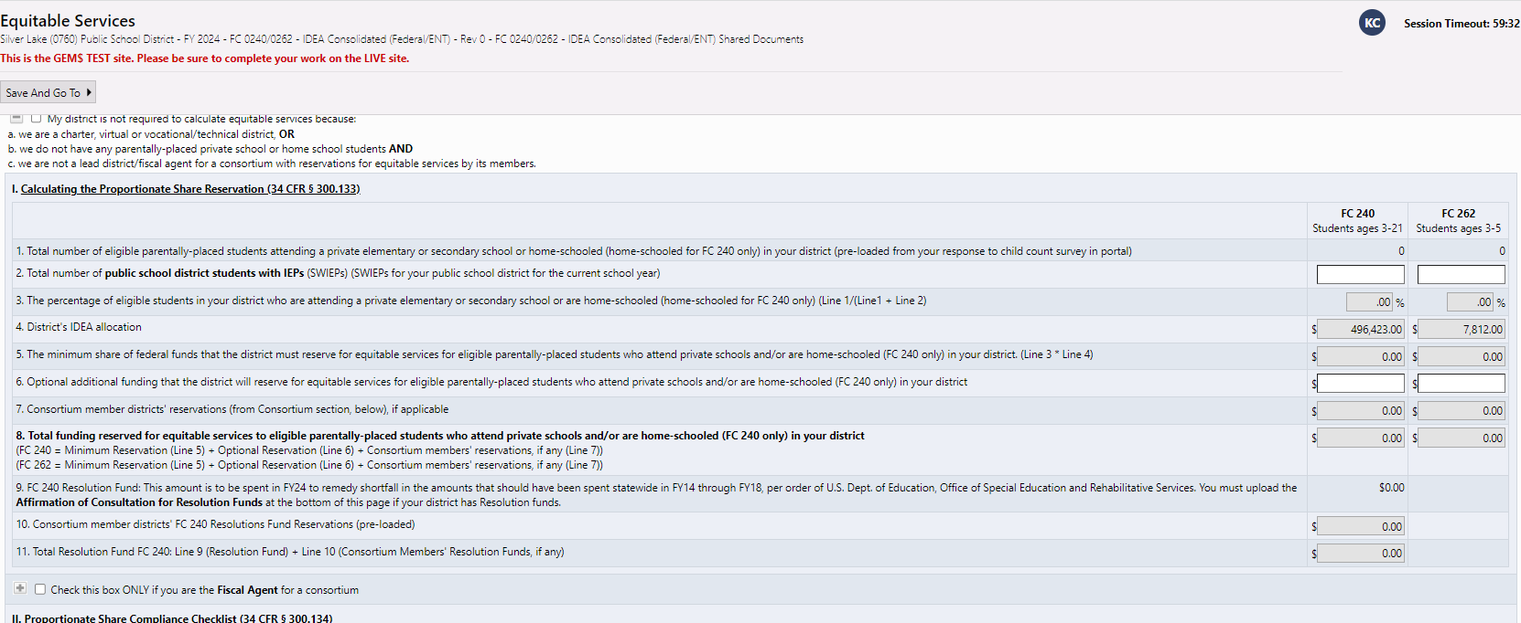
IDEA: Lead districts will transfer member districts’ equitable service information onto the lead district application

Slide 16
IDEA: Member districts’ equitable services reservations will be added to the total Equitable Services reservation that the Fiscal Agent will budget

Slide 17
Lead Districts need to pay special attention to special statuses for IDEA grants
In addition to Equitable Services, Lead Districts will need to look for and carry forward member districts’ reservations for:
Voluntary CEIS (Comprehensive Early Intervening Services)
Mandatory CCEIS (Comprehensive Coordinated Early Intervening Services)
^{M3 (Making Money Matter)}
There is a space in each of these three sections of the CEIS/CCEIS and Making Money Matter page of the IDEA Consolidated Application for Fiscal Agents to fill in their members’ reservations.

Slide 18
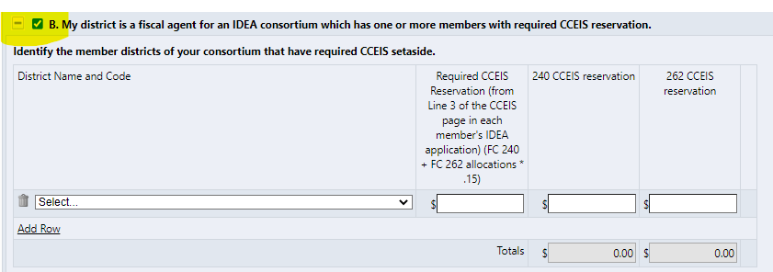
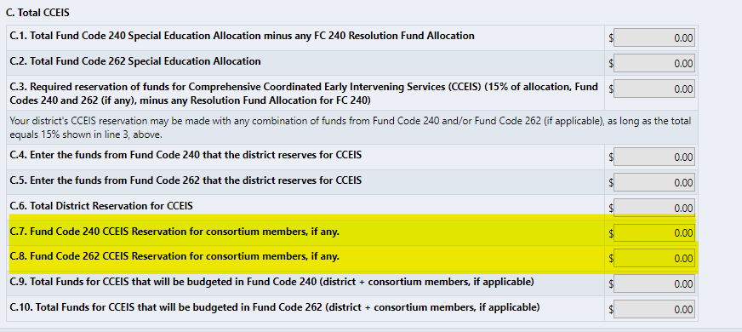
Mandatory CCEIS, for example
Mandatory CCEIS (Comprehensive Coordinated Early Intervening Services) – Districts that disproportionally identify certain students groups for special education in significant numbers are required to set aside 15% of their combined FC 240 and FC 262 (if any) allocations for early intervention services. See DESE Guidance for CCEIS.
The Fiscal Agent will check box B on its funding application (CCEIS section) and fill in any required CCEIS reservations from members’ funding applications (regardless of whether the Fiscal Agent is designated for CCEIS)
Any member districts’ funds for CCEIS will automatically carry forward to section C of CCEIS and be added to any amount that the Fiscal Agent must reserve from its allocation.

Slide 19
If there are different Fiscal Agents for the two IDEA grants, pay careful attention if members are required to reserve funds for CCEIS or voluntarily reserves funds for CEIS
In the rare instance when there are different Fiscal Agents for the two IDEA grants or a district joins a consortium for one grant but not the other, be careful to budget any CCEIS and CEIS reservations as indicated on the grant.
For example, Northborough 1) assigns its FC 240 funds to Northborough-Southborough but 2) is the Fiscal Agent for FC 262 for Southborough:
1
2

Slide 20
CCEIS – Different Fiscal Agents or One Fiscal Agent and One District-Administered Fund Code
Because CCEIS and CEIS can be split in any proportion between FC 240 and FC 262, the Fiscal Agent must be sure to copy only the reservation from the fund code it is administering
Example:
Northborough is lead district only for FC 262. If member Southborough reserved FC 240 funds of $1,200 and FC 262 funds of $400 for voluntary CEIS, Northborough would carry forward only FC 262 funds to its Northborough’s funding application:
Southborough’s $1,200 in FC 240 CEIS
funds will be budgeted, by
Northborough-Southborough, the
Fiscal agent for its FC 240 funds.
KEY: Fiscal Agent only carries forward reservations for the fund codes that it budgets

Slide 21
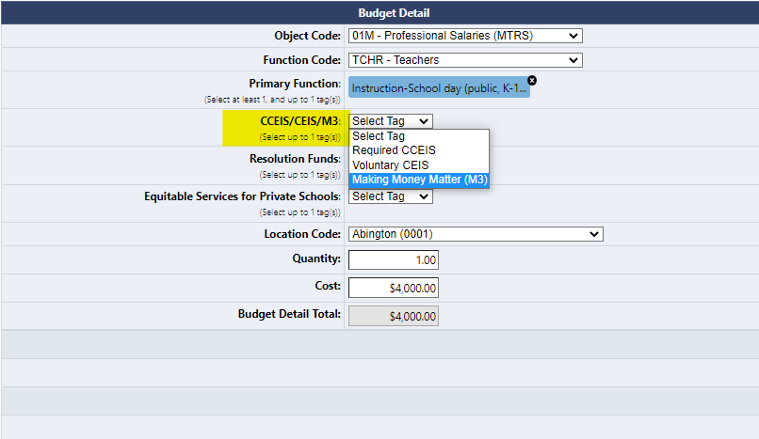
The Fiscal Agent will budget activities for CCEIS, CEIS, and M3 for all districts in the consortium on the Budget pages using budget tags for each reservation
Fiscal Agent will see Validation Error (“messages”) if the Fiscal Agent fails to budget all CCEIS/CEIS/M3 funds reserved on the CEIS/CCEIS and Making Money Matter page (total for Fiscal Agent and consortium members).
The validation is based on the budget tags – so be sure to select the appropriate one. Clicking on the “Messages” will tell you which reservations were not met.
Select appropriate budget tag from the dropdown

Slide 22
GEM$ Live Demo – IDEA Consolidated

Slide 23
ESSA Consolidated Funding Application

Slide 24
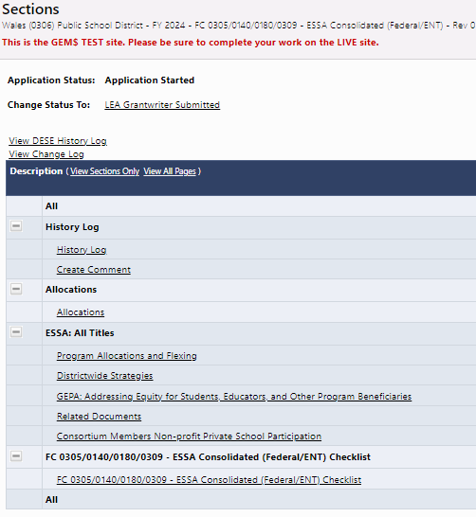
ESSA Consolidated (Title) Grants: Consortium members and Fiscal Agents need to work together more closely to get the required information for equitable services
As with IDEA, ESSA consortium will have
an abbreviated funding application to
complete.
The sections required of consortium
members are:
“Consortium Members Non-profit
Private School Participation”
GEPA Questions
Note: If your district is a member for only
one Title grant, but has other stand-alone
grant programs, your district should fill out
the remaining “ESSA: All Titles” pages and
the equitable services pages for these
Stand-alone grants.

Slide 25
ESSA Consolidated (Title) Grants: Consortium members and Fiscal Agents need to work together more closely to get the required information for equitable services
Consortium members will have a designated page in the “ESSA: All Titles” section of the ESSA Consolidated funding application to complete the equitable services for participating private schools students in their districts only for any/all of the Title grants (I, II, III, and/or IV)

Slide 26
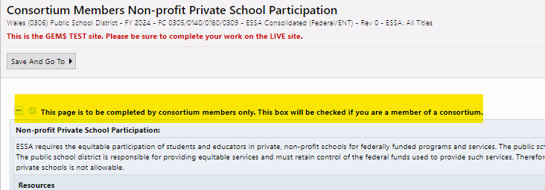
ESSA Title Grants: Consortium members have a designated Equitable Services page for their use only
Consortium members will check this box and enable this page.
Note: Fiscal Agents will complete Equitable Services pages for itself and bring in any members’ reservations in the main application.

Slide 27
ESSA Title Grants: Consortium members only need to complete equitable services pages for Titles covered by the consortium if its members have eligible private schools.
If you are a member of a consortium for only Title II, III and/or IV, you can check a box to hide Title I’s equitable services steps. If you are a consortium member for only Title I, you can check a box to hide Title II, III and IV’s equitable services steps.

Slide 28
Title I Equitable Services calculations require coordination between fiscal agent and any consortium member with participating nonprofit private schools
To facilitate ranking and serving the schools of the entire consortium (members and fiscal agent), all schools will be listed on the fiscal agent’s School Ranking page.
Consortium members will not have a School Ranking page.
Title I requires the number of district low-income students being served with Title I funds in order to calculate the proportionate share of funds for private schools.
Proportionate Share =
Conundrum: How does each consortium member and the fiscal agent know
which number to use for its Title I served low-income district students in the
denominator for its individual equitable services calculation?
Priv. School Would-be TI, Low Inc. Students
Priv. School Would-be TI, Low-Inc. Students + District TI School Low Inc. Students

Slide 29
Four steps to getting the numbers right for Title I equitable services
Step 1: Rank and Serve Title I Schools. The consortium/fiscal agent first must determine which schools for the consortium will receive Title I funding using the fiscal agent’s funding application.
Step 3: Each consortium member uses its own district totals. The consortium members will insert their number on their individual consortium members’ equitable services page only.
Step 2: Add up low-income, Title I-served students for any consortium district (consortium member and/or fiscal agent) with private schools participating in Title I. The School Code on the School Ranking tab of the fiscal agent’s funding application identifies the district that each school belongs to (first four digits = fiscal agent lea code, next four digits = member district lea code)
Step 4: Fiscal Agents put in the low-income total for its members on its application. The fiscal agent will put the total low-income enrollment for Title-I served schools for member districts where indicated on the main application (these students will be subtracted from all low-income students being served, leaving only the fiscal agent’s low-income students).

Slide 30
ESSA Title Grants: Fiscal Agents have a designated row on the main application where it will insert the total low-income enrollment for its members’ Title I-served schools.
Using this cell subtracts the members’ low-income students total from the school ranking page, leaving only low-income students for the fiscal agent’s Title-I-served schools, which will be used in calculating the fiscal agent’s Title I equitable services reservation (if any).

Slide 31
ESSA Title Grants: Last step – transfer member equitable services reservations to the main application to be budgeted by the fiscal agent.
The final step is for the fiscal agent to transfer any reservation for Equitable Services for Title I, II, III, and/or IV from the members’ applications to the applicable page on the main application
Note: The fiscal agent provides all information on the equitable services pages for each Title grant for its district and private schools only, except the reservations for any reservations for its consortium members, where indicated.

Slide 32
GEM$ Live Demo – ESSA Consolidated

Slide 33
Member districts have two options for conveying information to their Fiscal Agents (and vice versa for Title I)
Option | Pros | Cons
1) Provide your Fiscal Agent with the “LEA Data View” role for your district | Fiscal Agent can view and copy all necessary information from the members’ funding application into its “main” application for the consortium without the member having to do anything after completing its application | Fiscal agent will have access to view any at any stage of completion/approval/drawdown in the consortium member’s grant portfolio, including competitive grants. To limit this access, the consortium member can provide view access for a short period of time (create role and then delete role).
2) Provide your Fiscal Agent with a PDF of your completed pages of the funding application. | Limit outside access to your district’s grant portfolio, while providing the Fiscal Agent with the information from the members’ funding application it needs to complete its “main” application. Pages can be downloaded and “emailed” to the Fiscal Agent in GEM$ | Member districts must take the extra steps of printing and emailing its grant information to the Fiscal Agent. The Fiscal Agent needs to wait for the member districts to provide the information.

Slide 34
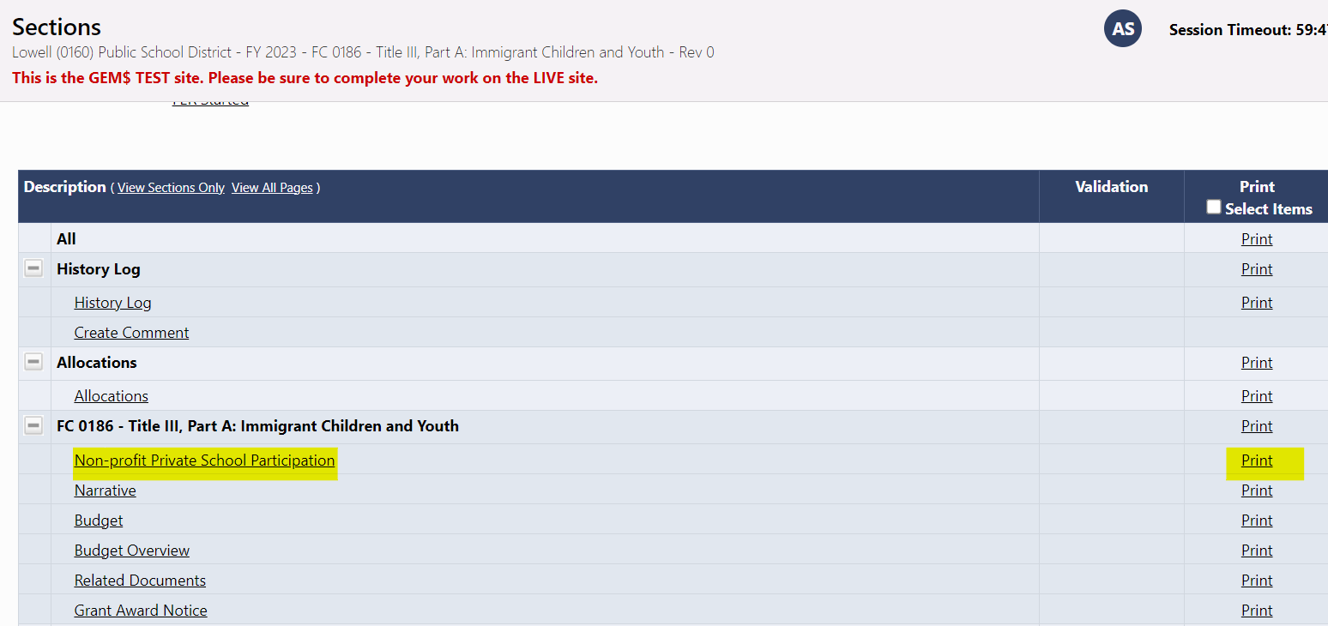
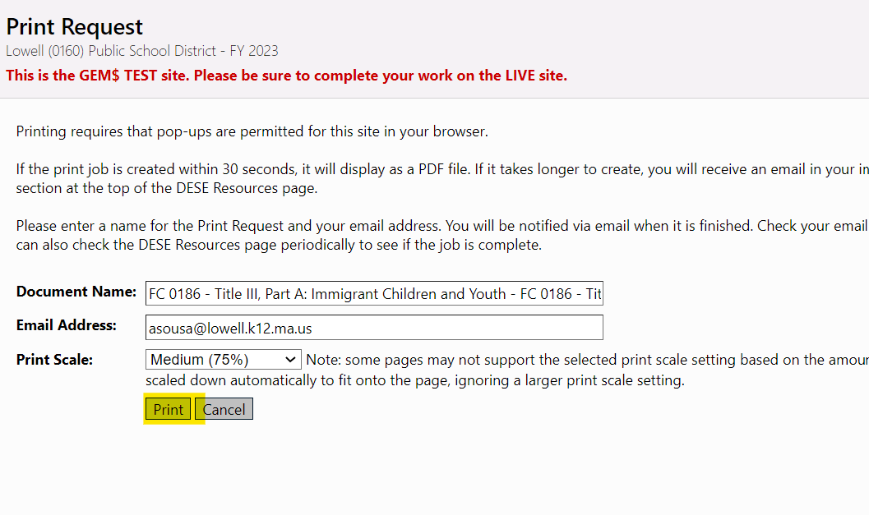
To create a pdf of its member pages, the member district selects “Print” from the Sections page of the funding application

Slide 35
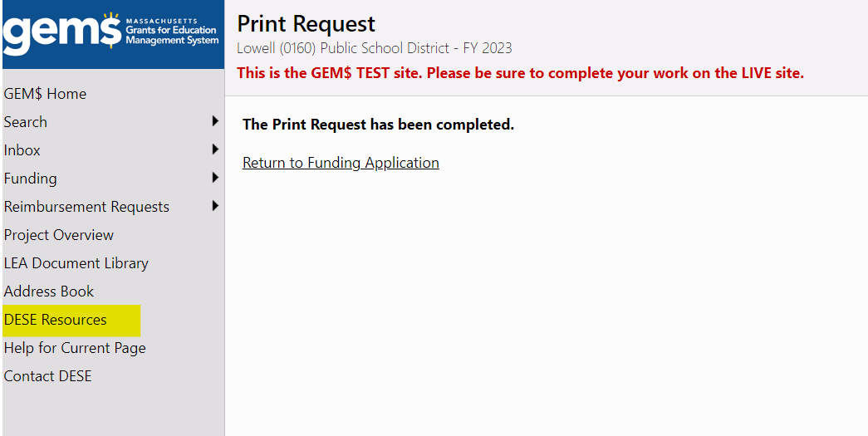
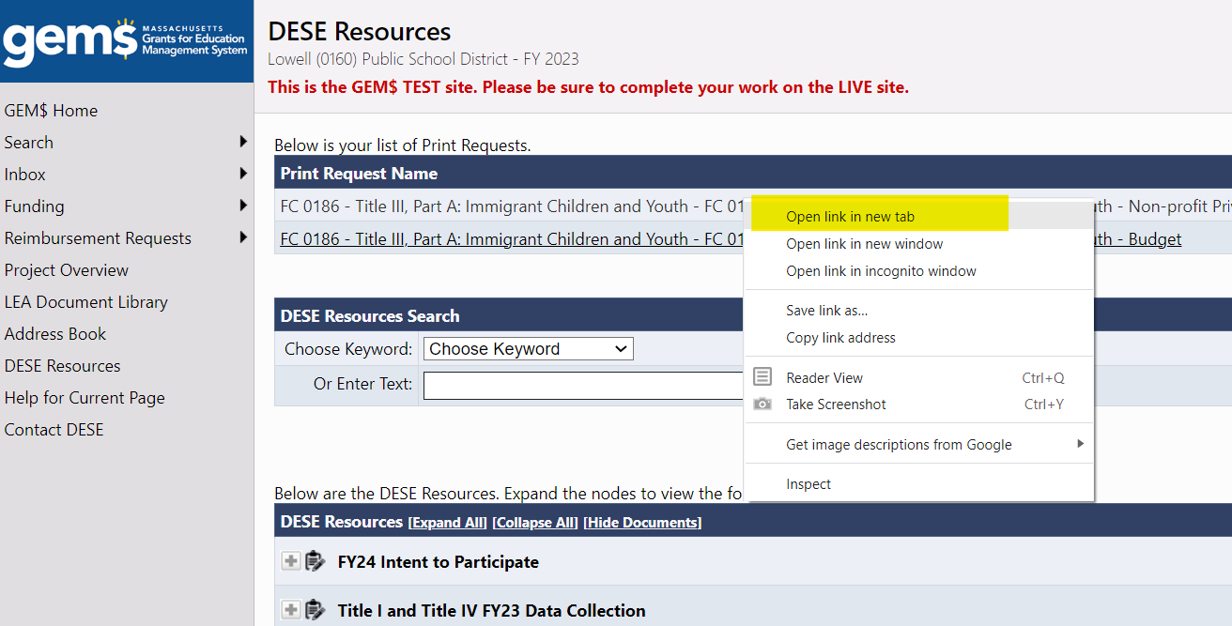
If your pdf does not show up in the lower left-hand corner of the screen immediately, select “DESE Resources” to retrieve it
Right click on the link and select “Open link in new tab.”

Slide 36
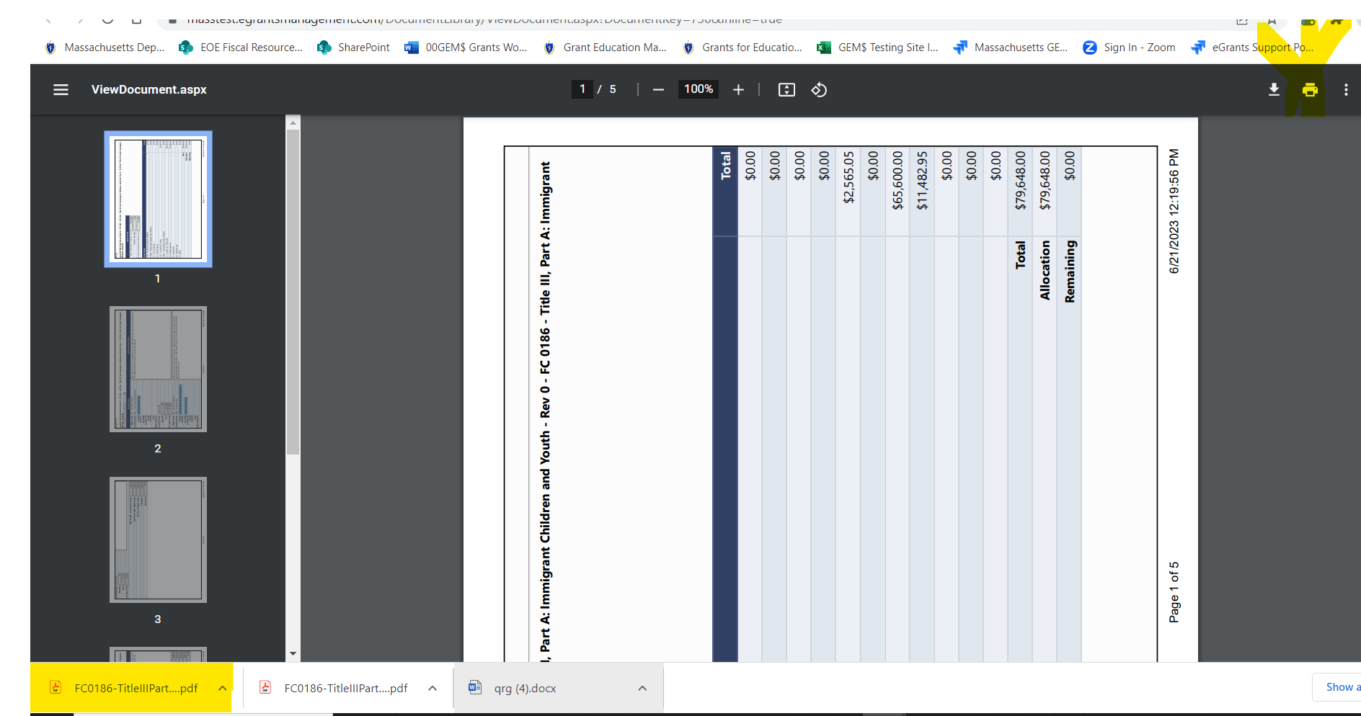
Download the pdf and save to your computer. A copy will appear in the lower left-hand corner of your screen.

Slide 37
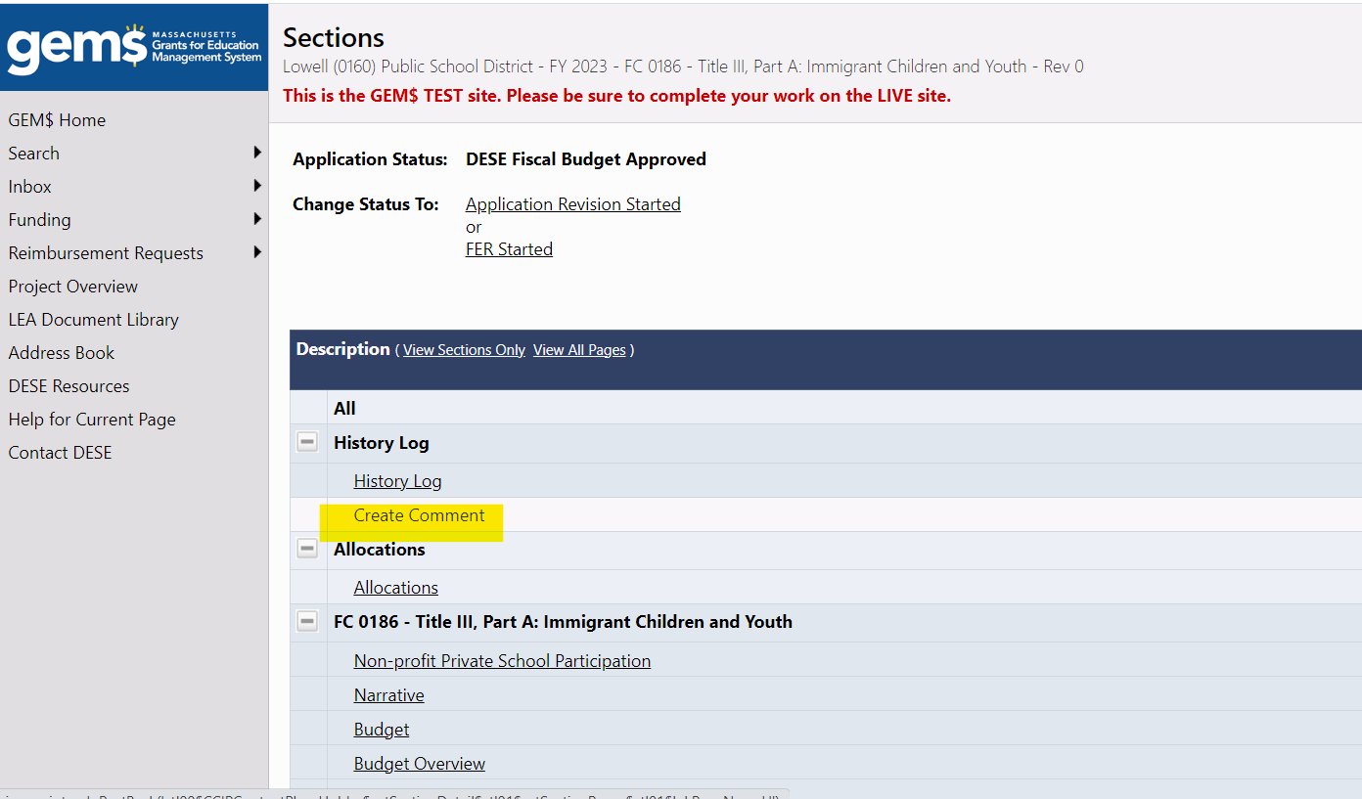
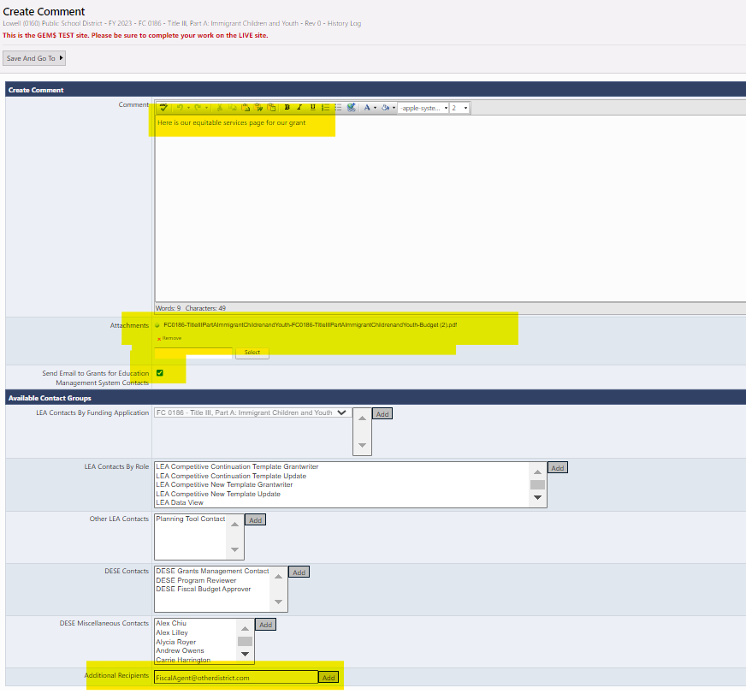
From the funding application Sections page, select “Create Comment”
Write your message, drag and drop the pdfs from the lower-left (or search and add from the saved location), check the box to see email options, type in your Fiscal Agent’s email address at the bottom and click “Add” then “Save and Go to” Sections page. The email will go to your Fiscal Agent and you will have record with your funding application.

Slide 38
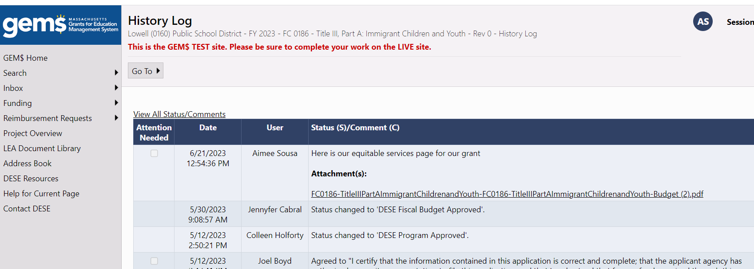
If you send the document to your Fiscal Agent through GEM$, you will be able to find it at any time through the History Log on the Sections page of your Funding Application.

Slide 39
Questions

Slide 40
Contact info/Thank you
Contact Information:
Kathy Cross, Kathleen.Cross@mass.gov

